Slide 1

21ECE42IT – Wireless Communication Networks
Programme: B.Tech. ECE
Offered by:
Prof. G. Vairavel, Ph.D.
Professor, ECE
Dean Academics and Educational Initiatives

Slide 2
Unit 1 – Introduction to Wireless Communication and Networks

Slide 3
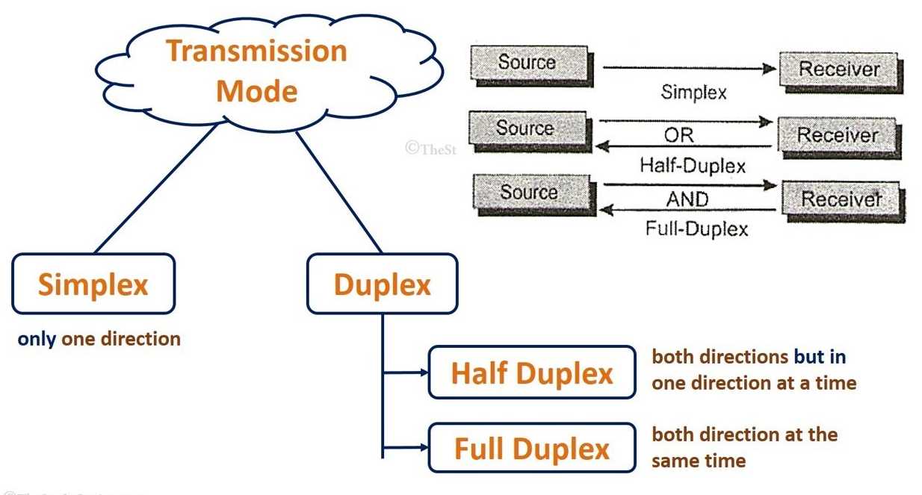
Classification of Wireless Communications/Networks

Slide 4
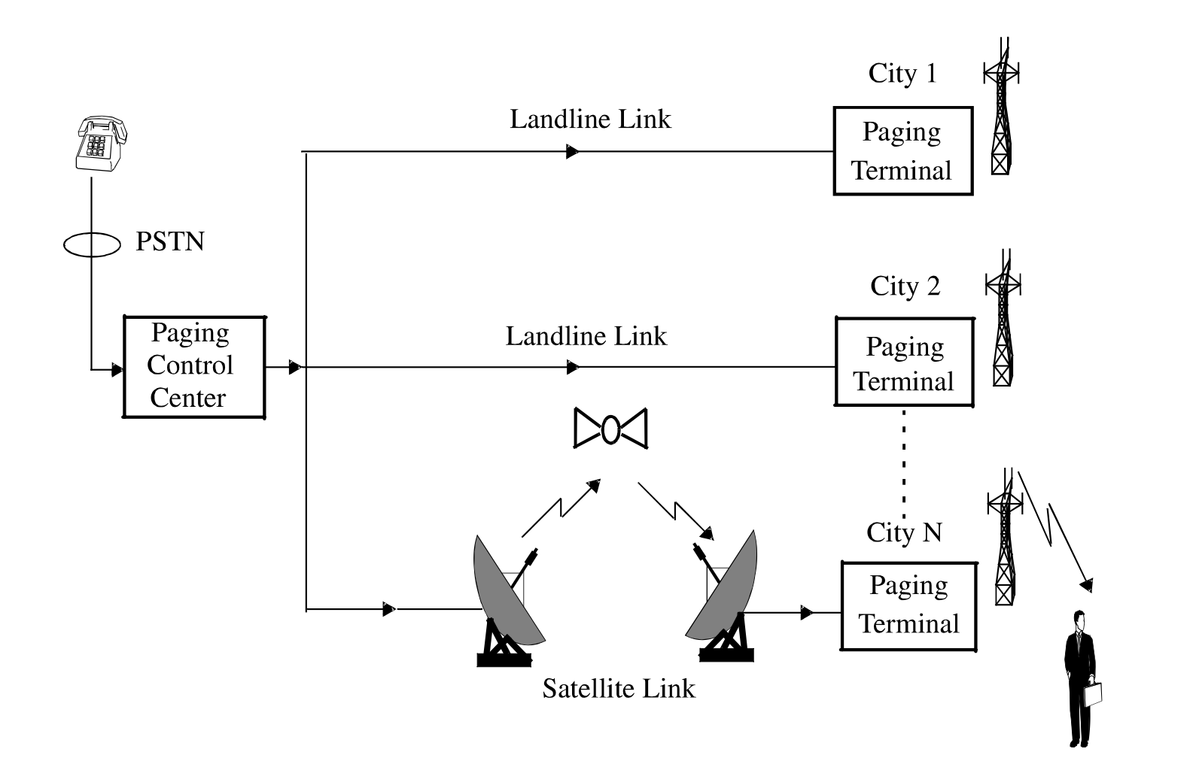
Paging System

Slide 5
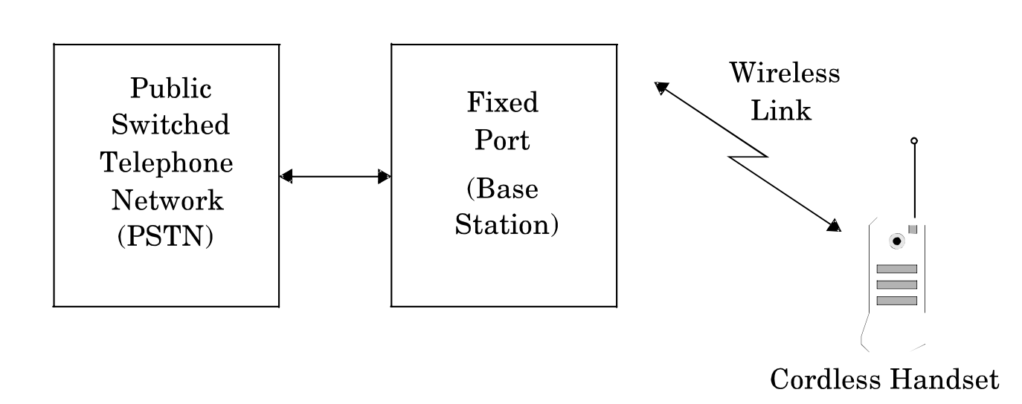
Cordless Telephone System

